Slide 1
Strategic Excellence
Prof. Marwa Tarek
Class 2

Slide 2
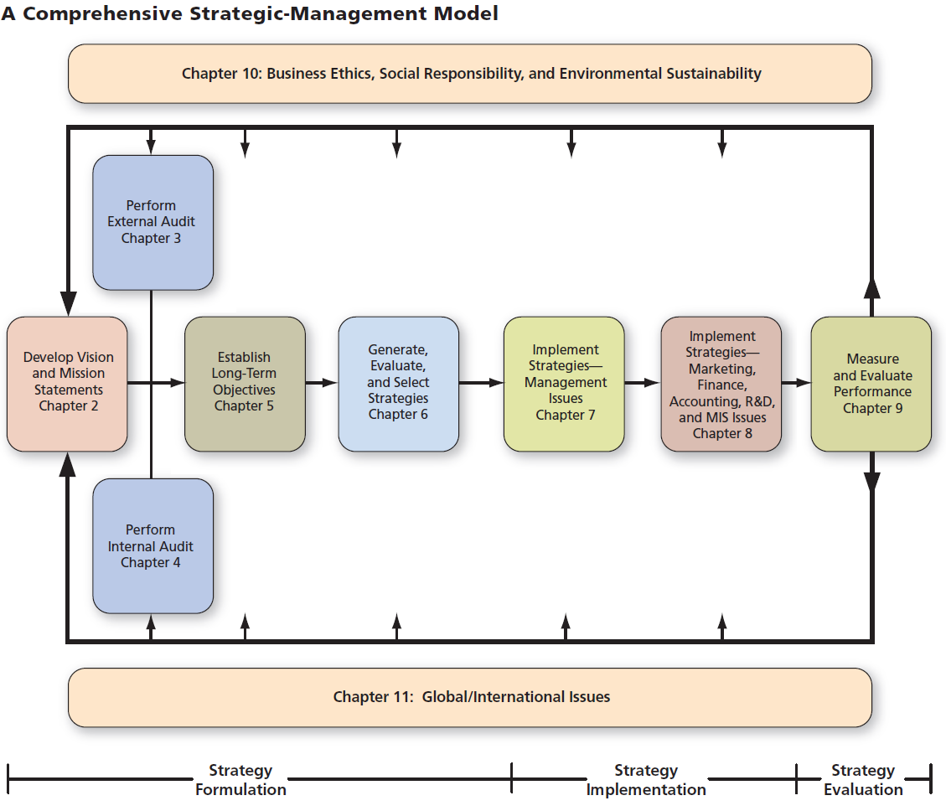
Strategic management process

Slide 3
Vision statement
The Importance of Vision
“Good business leaders create a vision, articulate the vision, own the vision, and drive it to completion.”
–Jack Welch, former CEO of General Electric
Vision= dream that you want to reach in your industry that your business is operating in.
What is the main criterion that I can depend upon to determine whether the vision is a good one?
The main criterion is that:
A vision statement should answer the basic question, “What do we want to become?”.

Slide 4
Vision statement
First thing you have to get: the current vision and mission.
If org. has no vision and mission, what you ll do???
Just formulate it.
1- Current vision and mission (If no current, go to propose directly)
2- Critique
3- Propose
Vision: you will not reach it in the short term, it is a dream not realistic now, it is future oriented and short (one or max 2 sentences).

Slide 5
Vision statement
A good vision structure has several key characteristics that make it inspiring, clear, and effective for guiding an organization or individual.
Below are the essential traits:
Clarity : A good vision is simple and easy to understand
Future-Oriented: Focuses on a desired future state
Inspirational: Motivates and energizes people to strive for excellence.
Unique: Reflects the distinct identity and purpose of the organization .
Short and Memorable: Concise and easy to remember.
Adaptable : Flexible enough to remain relevant as circumstances change (DYNAMIC ENVIRONEMENT).

Slide 6
Vision statement
Avon’s vision
is “to be the company that best understands and satisfies the product, service, and self-fulfillment needs of women—globally.”
This brief but powerful statement emphasizes several aims that are important to Avon, including excellence in customer service, empowering women, and the intent to be a worldwide player.
Like all good visions, Avon sets a high standard for employees to work collectively toward.

Slide 7
Vision statement
Not surprisingly, many organizations do not have formal visions. Many organizations that do have visions find that employees do not embrace and pursue the visions.
Having a well-formulated vision employees embrace can therefore give an organization an edge over its rivals.

Slide 8
Vision statement
Limitations of Vision :
1- Vision statements are generally not written in detail with specifications regarding the desired future position of the organization.
2- The vision statement only projects an image of what the organization wishes to achieve, but it does not tell if and how the organization will realize the desired goals.
3- The vision statements are so wide-ranging that the company can move in any direction.

Slide 9
Vision statement
Some of visions being pursued by businesses are offered below.
Company | Vision
Alcoa | To be the best company in the world–in the eyes of our customers, shareholders, communities and people.
Avon | To be the company that best understands and satisfies the product, service and self-fulfillment needs women–globally.
Chevron | To be the global energy company most admired for its people, partnership and performance.
Google | To develop a perfect search engine.
Kraft Foods | Helping people around the world eat and live better.
Proctor and Gamble | Be, and be recognized as, the best consumer products and services company in the world.

Slide 10
Vision statement
Examples of vision statement:
1- Tyson Foods’ vision is to be the world’s first choice for protein solutions while maximizing shareholder value.
2- Dubai International Financial Centre’s vision is to shape tomorrow’s financial map as a global gateway for capital and investment.
3- General Motors’ vision is to be the world leader in transportation products and related services.

Slide 11
Vision statement
Examples of vision statement:
PepsiCo’s responsibility is to continually improve all aspects of the world in which we operate – environment, social, economic – creating a better tomorrow than today.
Samsonite’s vision is to provide innovative solution for the travelling world.

Slide 12
Vision statement
Examples of vision statement:
Dell’s vision is: “It’s the way we do business. It’s the way we interact with the community. It’s the way we interpret the world around us– our customers’ needs, the future of technology, and the global business climate.
Procter & Gamble’s vision is to be the best consumer products company in the world.

Slide 13
Mission statement
Mission: Focuses on the present and explains what the organization does
Clear Business vision leads to
Comprehensive mission Statement
Answers the question:
- “What is our business?”
It reveals:
What the organization wants to be?
Whom we want to serve?
Essential for:
- Effectively establishing objectives and formulating strategies

Slide 14
Mission statement
Longer than vision
It includes:
1- customer
2- product or service
3- Market
4-Technology
5- Concern for survival, growth and profitability
6- Philosophy
7- Self-concept
8- Concern for public image (all are used in marketing and achieve profits in real life).
9- Concern for employees
Mission should include at least 7 points, it is ok, if less than you have to propose….
If no mission, so propose directly.
To formulate vision and mission should communicate with the stakeholders to shape the vision and mission.

Slide 15
Mission statement
Mission Statements are also called
Creed statement
Statement of purpose
Statement of philosophy
Statement of beliefs
Statement of business principles
A statement “defining our business”

Slide 16
Mission Statement Components
We have some questions to be answered to develop mission statement. These answers are included in an essay format not in terms of questions:
1.Customer: Who are the firm’s customers?
2.Products or services: What are the firm’s major products or services? (we need to focus on the major because the company may produce multiple products).
3.Markets: Geographically, where does the firm compete?

Slide 17
Mission Statement Components
4.Technology: Is the firm technologically current?
Technology has two categories:
-Core technology refers to technology used by the company to transfer the input to ouput (product /service). It is directly related to the organization mission.
(teaching in school, medical services in a clinic).
Ex: in the university, the technology is used by the profs. and assistants that use to deliver the lectures and sections.
-Non-core technology refers to technology that used by departments which support the main work process but is not directly related to the organization mission.
Ex: in the university (HR, Accounting, R&D and finance departments) are using technology to accomplish their tasks which support the teaching process which is (the core work process in the university).

Slide 18
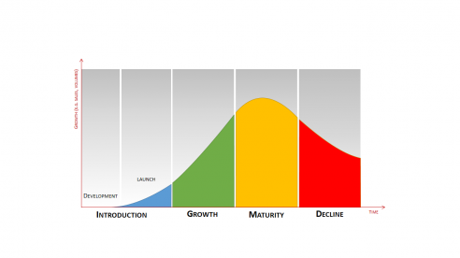
Mission Statement Components
5. Concern for survival, growth, & profitability: Is the firm committed to growth and financial soundness?
- If we talk about the organizational life cycle.
If the company knows how to grow, to survive, and to make profits it can survive and reduce the opportunity to decline.

Slide 19
Mission Statement Components
6.Philosophy: What are the basic beliefs, values, aspirations, and ethical priorities of the firm? (which guide the process inside the company, how to deal with colleagues, your bosses, your followers, the customers, etc…such as transparency).
7.Self-concept: What is the firm’s distinctive competence or major competitive advantage? Something that I do have and the competitors don’t have.
8.Concern for public image: Is the firm responsive to social, community, and environmental concerns? The value that I add to the public as a social responsibility.
9.Concern for employees: Are employees a valuable asset of the firm? The most important resources at any company.

Slide 20
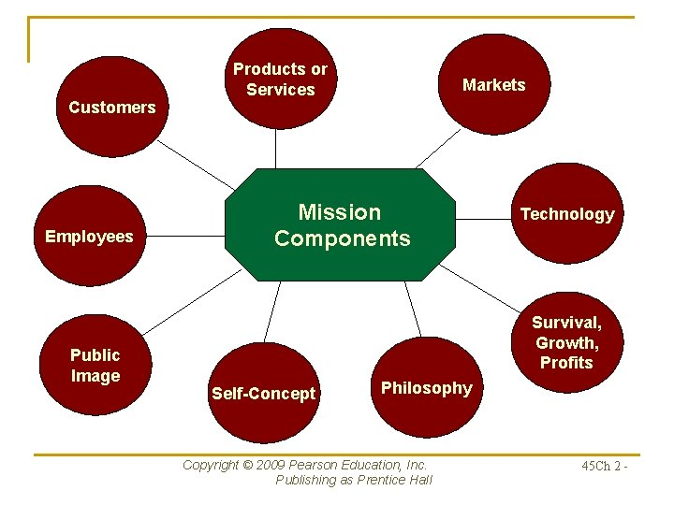
Mission statement

Slide 21
Mission Statement Components
The question is: should I include all of these components into my mission statement?
The answer is: No.
I can include some components or part of it according to your decision as a strategist, as he/she decides on the most important components should be included. However to develop a comprehensive mission statement I have to include all of them.

Slide 22
Three crucial components of the mission
Components cannot be ignored:
Basic Product/service (2)
Primary market (3)
Principal technology (4)
If you decide to use them in your mission statement, it is called “silver bullet” mission for the outsiders to make it much more easier to read it.

Slide 23
Mission Statement Examples
Dell’s mission is to be the most successful computer company in the world at delivering the best customer experience in markets we serve. In doing so, Dell will meet consumer expectations of highest quality; leading technology; competitive pricing; individual and company accountability; best-in-class service and support; flexible customization capability; superior corporate citizenship; financial stability.

Slide 24
Mission Statement Examples
Dell’s mission is to be the most successful computer company (2 product) in the world (3 market) at delivering the best customer experience in markets we serve (1customer). In doing so, Dell will meet consumer expectations of highest quality (10 quality); leading technology (4 technology); competitive pricing; individual and company accountability (6 philosophy); best-in-class service and support (7 self-concept); flexible customization capability (7 self-concept); superior corporate citizenship (8 concern for public image); financial stability (5 concern for survival).
– Statement lacks only 1 component: Concern for Employees.
Comment: the first statement is the vision as it answers the question of (what Dell’s wants to become?). Many companies can merge vision and mission statements together in one statement in order to communicate their vision with mission together.

Slide 25
Mission Statement Examples
Tesla's mission is to accelerate the world's transition to sustainable energy. To achieve our mission, we're building a world powered by solar, enabled by battery storage and transported by electric vehicles (EV). Tesla's EVs include the following - Cybertruck, Model S, Model 3, Model X and Model Y.
Eva Pharma:A purpose driven diverse top team that strives to save and improve millions of lives by sustainably offering accessible, high value medicines and health care solutions that address local patients' needs.

Slide 26
Mission Statement Examples
Fleetwood Enterprises will lead the recreational vehicle and manufactured housing industries in providing quality products with a passion for customer-driven innovation. We will emphasize training, embrace diversity and provide growth opportunities for our associates and our dealers. We will lead our industry in the application of appropriate technologies. We will operate at the highest levels of ethics and compliance with a focus on exemplary corporate governance. We will deliver value to our shareholders, positive operating results and industry-leading earnings.

Slide 27
Mission Statement Examples
Fleetwood Enterprises will lead the recreational vehicle and manufactured housing industries (2,7 product/self-concept) in providing quality products with a passion for customer-driven innovation (1 customer). We will emphasize training, embrace diversity and provide growth opportunities for our associates and our dealers (9 concern for employees). We will lead our industry in the application of appropriate technologies (4 technology). We will operate at the highest levels of ethics and compliance with a focus on exemplary corporate governance (6 philosophy). We will deliver value to our shareholders, positive operating results and industry-leading earnings (5 concern for survival).
– Statement lacks 2 components: Markets and Concern for Public Image.

Slide 28
Core values are the fundamental principles & beliefs that guide a company’s behavior, decision-making, & culture. They represent what the organization stands for & influence how employees act, how the company interacts with stakeholders, & how it pursues its strategic goals.

Slide 29
Values types are 4
1- Generic Values (1-2)
To get core values, you have to get the qualities in industry (common in all org in this industry).
It should be available in your company
2- Shadow Values (1-2)
These are the values that outsiders perceive in the organization but may not be fully acknowledged internally.
To get it , we can make a survey from outsiders, which is very important to them to deal or not to deal with the org.
It may be positive or negative
If negative (Marketers should work on it to communicate to outsiders)
If positive, I have to take it into consideration
e.g., I am selecting people by certain attributes that consistent with our values which is reflecting on the outsiders and it may hurt my branding if I did choose wrongly.
You may be a good person but you are not fitting in our org.
(graduated from bad reputation university)

Slide 30
Values types are 4
3- Progressive values (1-2)
These are emerging values actively promoted internally, often driven by leadership to shape culture for future goals.They reflect what the organization is working toward, rather than fully achieved yet.Example: A CEO encouraging sustainability practices or digital transformation initiatives
Values that insiders are working on (It is coming from CEO- top mgt).
4- Core values (defined values)
The overall previous values

Slide 31
So core values are very critical to shape the org culture.
It is the origin (starting point) of branding.
First of all you have to analyze the 3 sources of the values and then compare it with the core values that you already have in the website or documents of org….If they are close, this is good, if no, we have a big problem now in values.
If you are a new org, it is ok…propose..
From practical perspective, core values are the most important ones.
It shapes the organizational culture

Slide 32
Assignment 1:
Choose a company and write a summary about it
Company Summary:
Company name and industry
Founding date and headquarters
Main products or services
Target market and customers
Major achievements or awards
Number of employees and company size
Write the vision, mission, and core values, and provide a critique

